Slide 1
Michael Allen Sprint #5 Review
Exploratory & Analysis of
US Contagious Diseases

Slide 2
Game Plan
1. Read into R a CSV file Containing US Contagious Diseases
2. Use R to Perform Initial Exploratory Analysis
3. Learn How to Utilize the Filter within R Studio to Assist in the Analysis
4. Write a Script to Calculate the Disease per State by the Highest Percentage Sick
5. Write a Script to Calculate the Specific disease per State by the Highest Percentage Sick
6. Perform ANOVA Calculations on Entire Dataset to Determine if there is Statistical Significance on Percentage Sick per Disease Basis

Slide 3
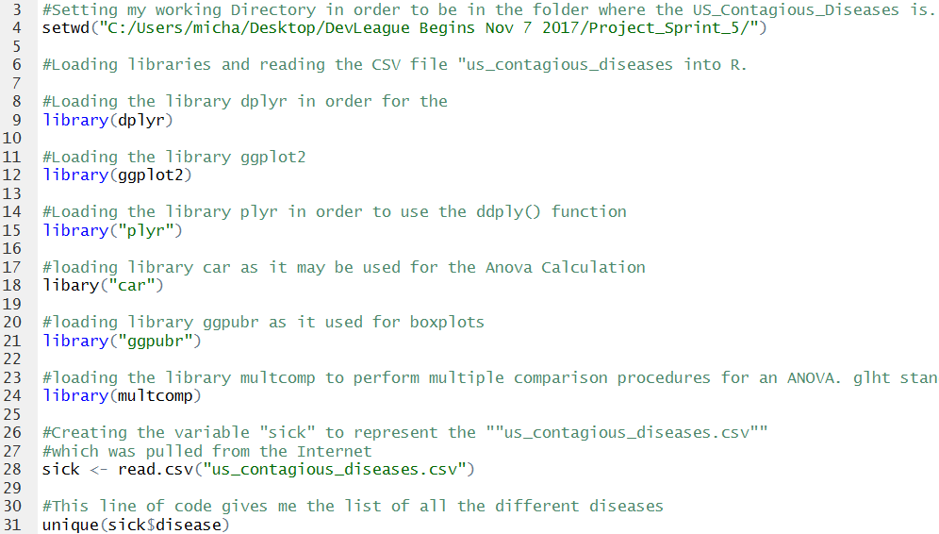
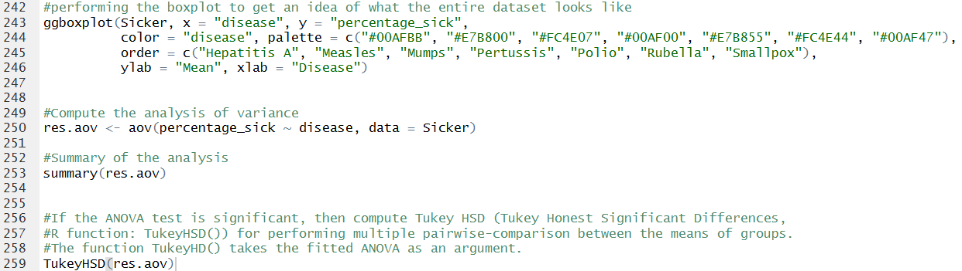
Create a Script in R to Perform Various Exploratory Analysis

Slide 4
Viewing the Highest Sick Percentage after Calculation

Slide 5
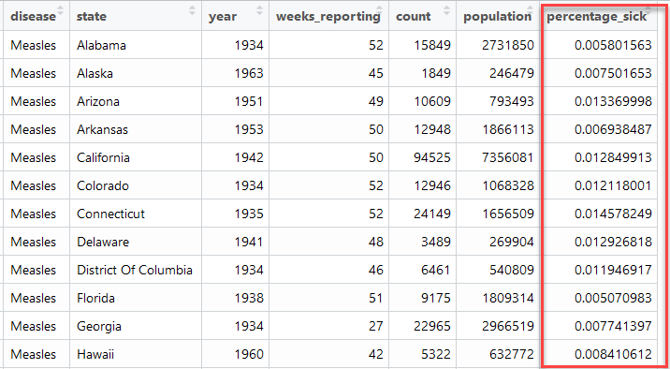
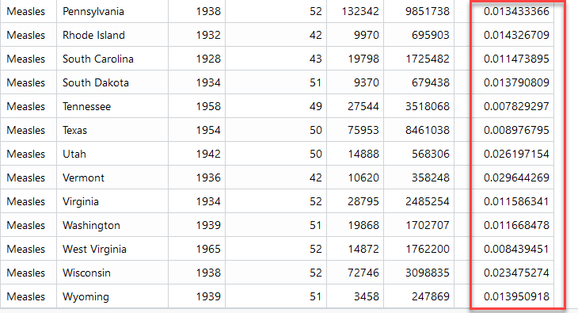
Calculating Each State’s Highest Percentage of Being Sick

Slide 6
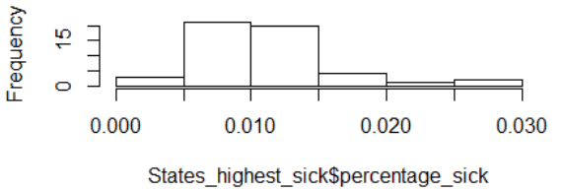
Calculating the Mean for All States for the Highest Percentage Sick
And Histogram

Slide 7
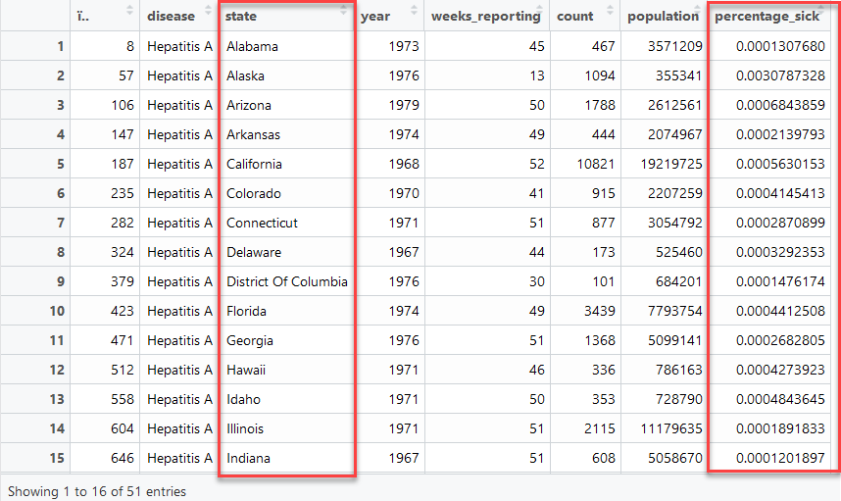
Calculate Specific Disease per State by the Highest Percentage Sick

Slide 8
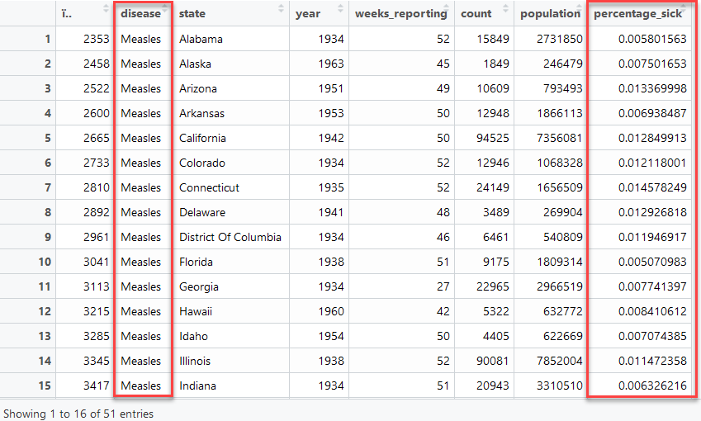
Calculate Specific Disease per State by the Highest Percentage Sick

Slide 9
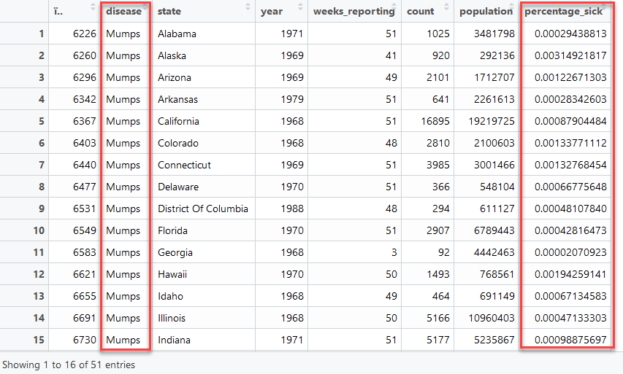
Calculate Specific Disease per State by the Highest Percentage Sick

Slide 10
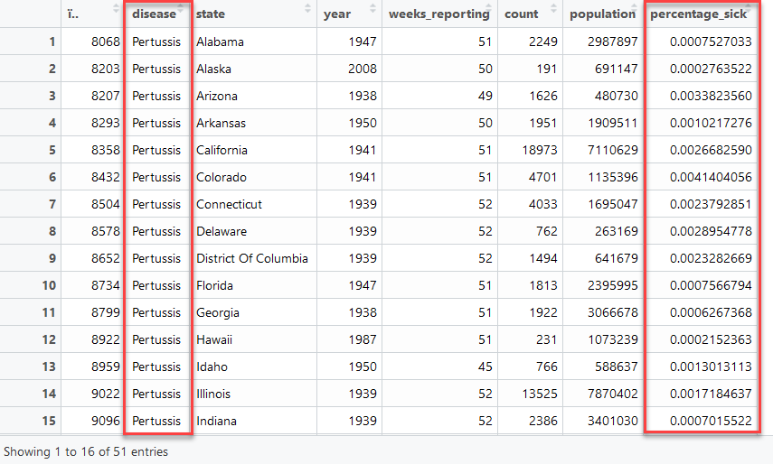
Calculate Specific Disease per State by the Highest Percentage Sick

Slide 11
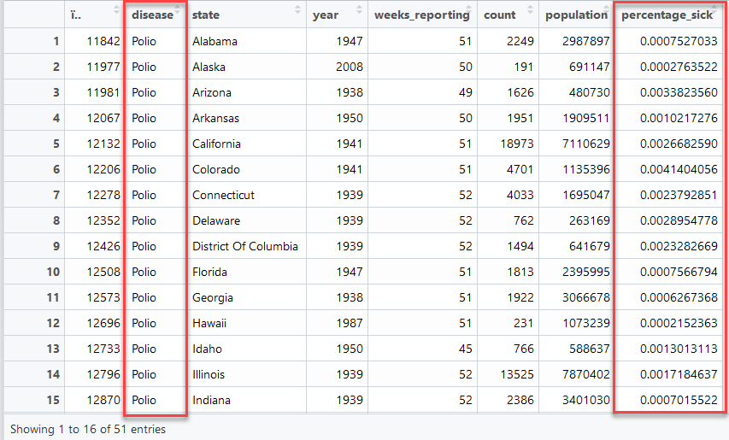
Calculate Specific Disease per State by the Highest Percentage Sick

Slide 12
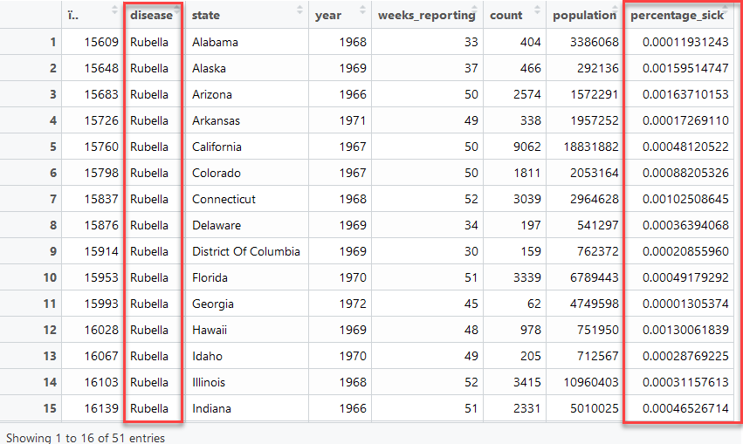
Calculate Specific Disease per State by the Highest Percentage Sick

Slide 13
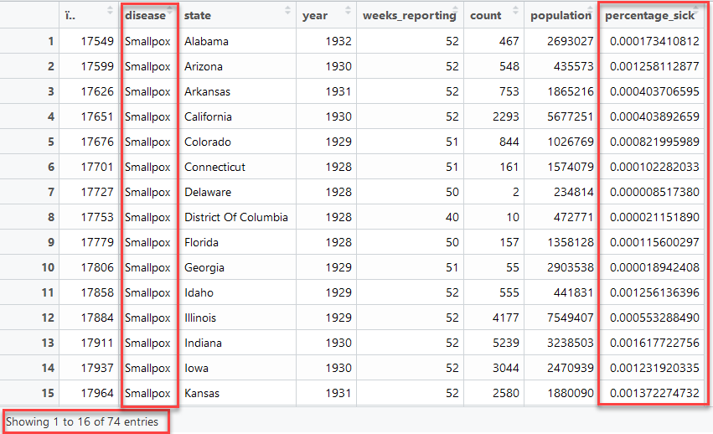
Calculate Specific Disease per State by the Highest Percentage Sick

Slide 14
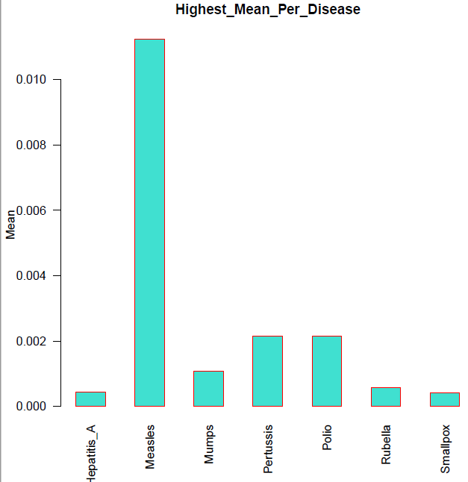
Highest Mean Per Disease

Slide 15
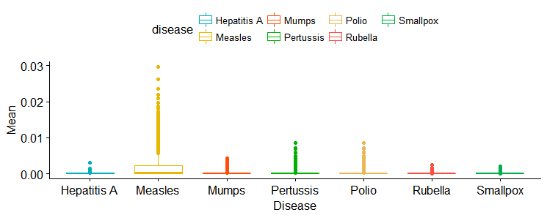
Parameters of the Boxplot of “Entire” Dataset

Slide 16
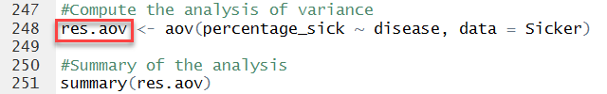
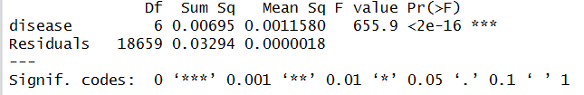
Analysis of Variance - ANOVA

Slide 17
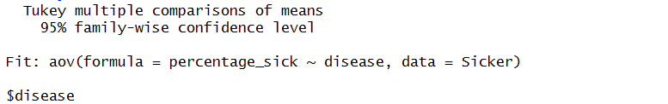
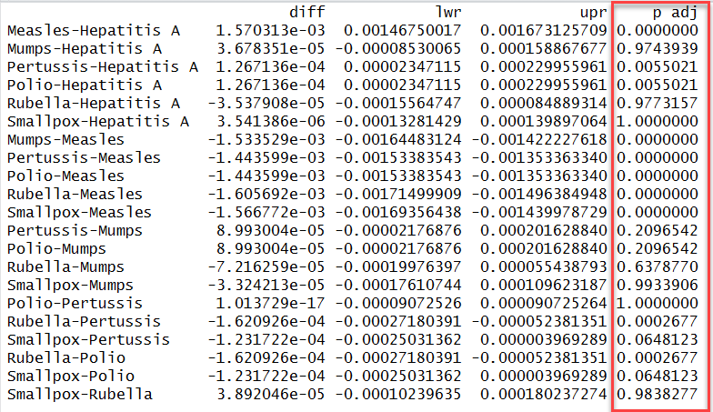
Analysis of Variance - ANOVA

Slide 18
Thank you

